Slide 1
JEOPARODY JEOPARODY JEOPARODY JEOPARODY JEOPARODY JEOPARODY JEOPARODY JEOPARODY JEOPARODY JEOPARODY JEOPARODY JEOPARODY JEOPARODY JEOPARODY JEOPARODY JEOPARODY JEOPARODY JEOPARODY JEOPARODY
CREE JEOPARDY
JEOPARODY JEOPARODY JEOPARODY JEOPARODY JEOPARODY JEOPARODY JEOPARODY JEOPARODY JEOPARODY JEOPARODY JEOPARODY JEOPARODY JEOPARODY JEOPARODY JEOPARODY JEOPARODY JEOPARODY JEOPARODY JEOPARODY

Slide 2
FAQ:
Q. Is this game officially licensed by Jeopardy!?
A. No it’s not. This game is a PARODY game.
Q. How do I reset the links on the main board back to yellow?
A. Simply close the PowerPoint file, and re-open, and the links will turn back to yellow.
Q. Why aren’t the sound effects working?
A. If the sound effects aren’t working, I would suggest upgrading your PowerPoint to something newer than 2008, and using a PC instead of a Mac if possible. Also, Google slides, Keynotes, etc. are not supported.
Q. Can I get a board with less categories? Can I add a custom logo?
A. Unfortunately these changes are a little too complex for me to explain or assist you via email, but if you’d like me to do a custom job for you for a small fee, send me an email at Reid@youthdownloads.com.

Slide 3
HERE ARE TODAY’S CATEGORIES

Slide 4
Numbers

Slide 5
Weather

Slide 6
Animals

Slide 7
Professions

Slide 8
Mode of Transportation

Slide 9
Family Relations

Slide 10
Mode of Transportation
Family Relations
Numbers
Weather
Animals
Professions
$100
$100
$100
$100
$100
$100
$200
$200
$200
$200
$200
$200
$300
$300
$300
$300
$300
$300
$400
$400
$400
$400
$400
$400
$500
$500
$500
$500
$500
$500
FINAL JEOPARODY

Slide 11
2

Slide 12
Niso

Slide 13
7

Slide 14
Tepakohp

Slide 15
4

Slide 16
Neyo

Slide 17
10

Slide 18
Mitataht

Slide 19
14

Slide 20
Mitataht-neyosap

Slide 21
It is raining

Slide 22
Kimiwan

Slide 23
It is snowing

Slide 24
Mispon

Slide 25
It is cold

Slide 26
Kisinaw

Slide 27
It is foggy

Slide 28
Pikiseyaw

Slide 29
It is windy

Slide 30
Notin

Slide 31
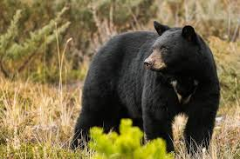

Slide 32
Mahkwa

Slide 33
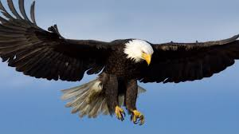

Slide 34
Mikisiw

Slide 35
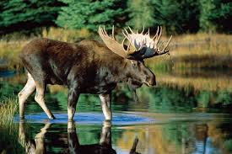

Slide 36
Moons

Slide 37
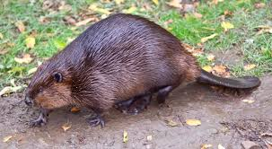

Slide 38
Amihk

Slide 39
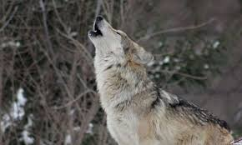

Slide 40
Mahiinkan

Slide 41
Hunter

Slide 42
Otantawencike

Slide 44
Mashkihkiiwinini

Slide 45
Chief

Slide 46
Okimaahkaan

Slide 47
Teacher

Slide 48
Otishkooniihiwe

Slide 49
Police Officer

Slide 50
Shimaakanish

Slide 51
Walk

Slide 52
Pimohse

Slide 53
Truck

Slide 54
Otaapaan

Slide 55
Canoe

Slide 56
Ciimaan

Slide 57
Flying in a plane

Slide 58
Piminaa

Slide 59
Train

Slide 60
Ishkotewitaapaan

Slide 61
Mother

Slide 62
Okawimaw

Slide 63
Father

Slide 64
Ohtawimaw

Slide 65
My Aunt

Slide 66
Nicooshish

Slide 67
My cousin

Slide 68
Ninciicehc

Slide 69
My grandmother

Slide 70
Noohkom

Slide 72
How do you say, “Band Office”
GO TO
PROMPT
(RESPONSE)
Start Timer

Slide 73
Aan Ehkitoyan Masinahkewikamik

